Slide 1

BIOMEDICAL WAST MANAGMENTS
Presented by
Prof.Dr. Saad S. Mahdi Al-amaradi Al-Amara
Department of Pathological Analyses

Slide 2

BIOMEDICAL WASTE:
Definition
Bio-medical waste means “any solid and/or liquid waste produced during diagnosis, treatment or vaccination of human beings or animals.
Biomedical waste creates hazard due to two principal reasons: infectivity and toxicity.

Slide 3
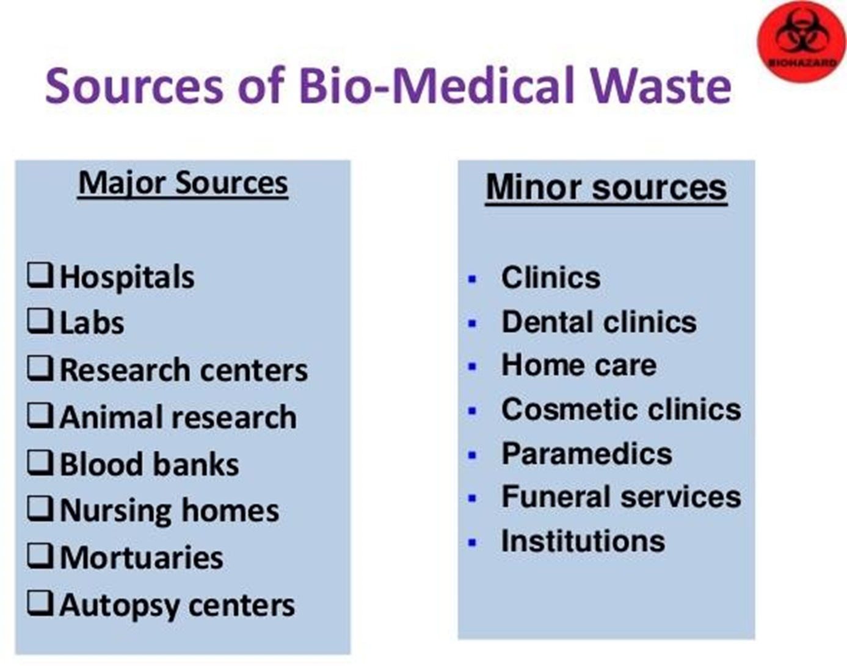

Slide 4


Classification:
The classification of the biomedical waste is carried out based on its characteristics, source of generation and the level of hazard to the environment.
The biomedical waste is classified into two types:
1.Non hazardous waste
2.Hazardous waste

Slide 5




Non-hazardous waste: About 75% to 90 % of biomedical waste characteristics were similar to that of domestic waste and are non- risky in nature. This waste is generated mainly from the organization and maintenance of hospital and health care centers.
Hazardous waste: The remaining 10 – 25% of biomedical waste falls under the hazardous waste categories. The hazardous waste contains infectious characteristics of about 15% - 18 % and toxicity characteristics of about 5% - 7%. The various hazardous wastes includes,

Slide 6
  Infectious waste: Waste containing pathogens; e.g. excreta; laboratory cultures; isolation wards waste; swabs, materials, or equipments that have been in contact with infected patients.
  Pathological waste: Human tissues or fluids e.g. body parts; blood and other body fluids; fetuses.
  Pharmaceutical waste: Waste containing pharmaceuticals; e.g. pharmaceuticals that are expired or no longer needed; contaminated pharmaceuticals (bottles, boxes).
  Genotoxic waste: Waste containing cytostatic drugs (often used in cancer therapy)/ genotoxic chemicals.

Slide 7
  Chemical waste: Waste containing chemical substances e.g. laboratory reagents; film developer; disinfectants and solvents that are expired or no longer needed.
  Wastes with high content of heavy metals: Batteries, Broken thermometers, blood pressure gauges, Pressurized containers, gas cylinders, gas cartridges, aerosol cans.
  Radioactive waste from radiotherapy: Waste containing radioactive substances e.g. unused liquids from laboratory research; contaminated glassware, packages or absorbent paper; urine and excreta from patients treated or tested with uncapped radionuclide

Slide 8
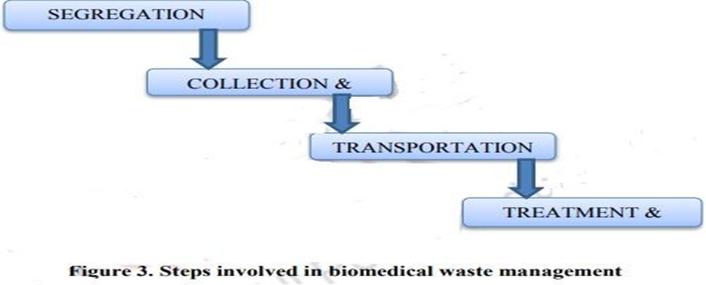
Biomedical Waste management:
  Proper management of biomedical waste is highly essential since it induces various risk to the human health and to the surrounding ecosystem that leads to the ecological hazard, professional hazard and public hazard. Steps involved in biomedical waste management

Slide 9
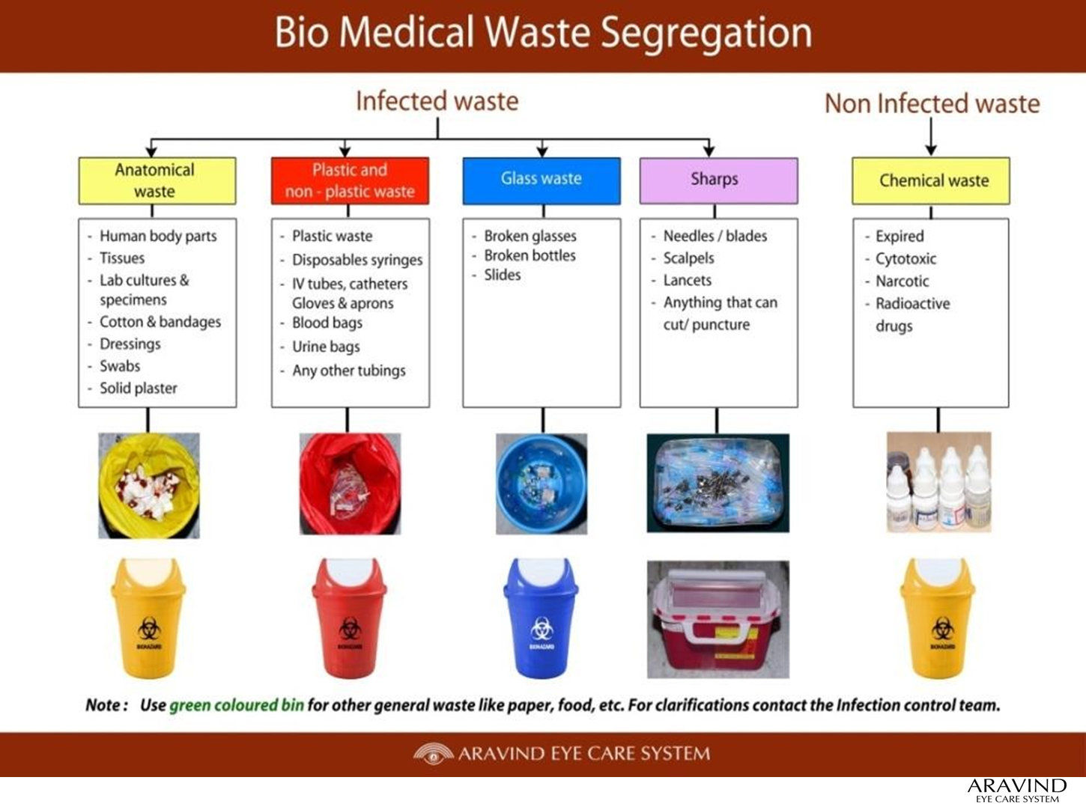

Slide 10
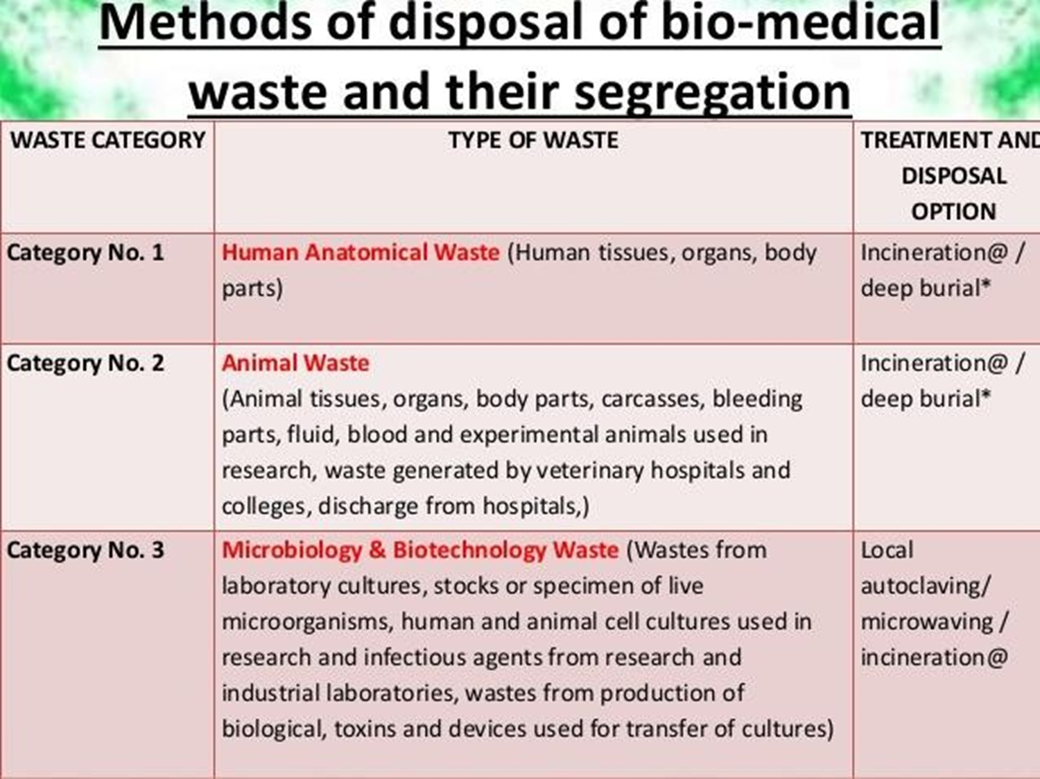

Slide 11
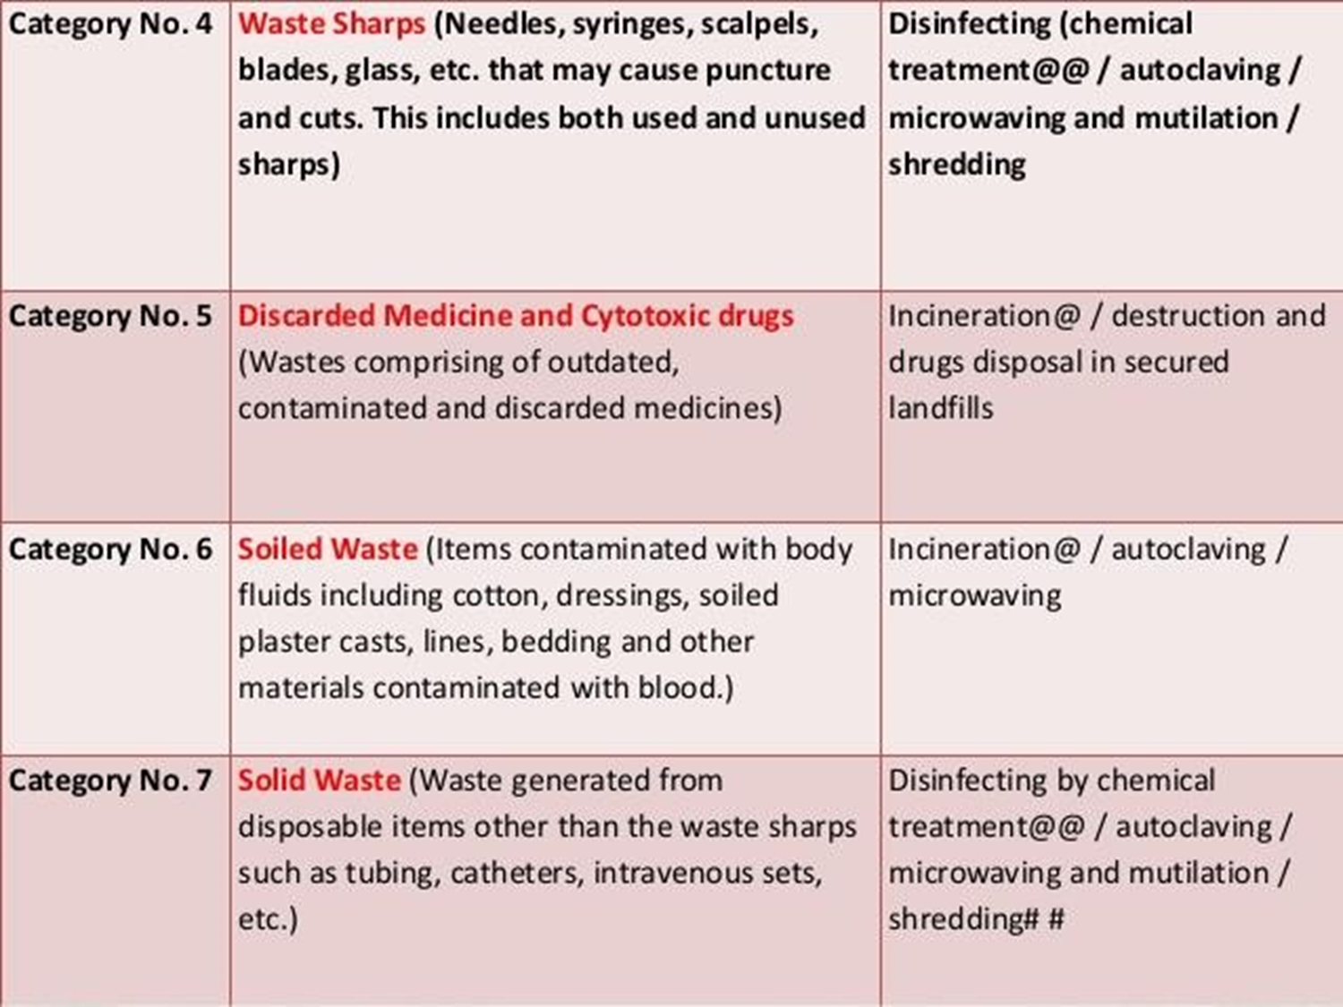

Slide 12
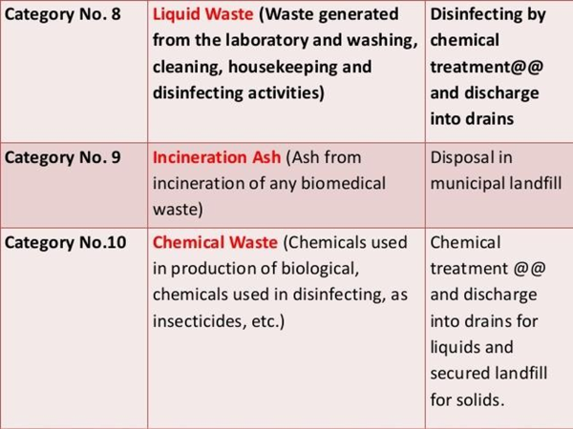

Slide 13
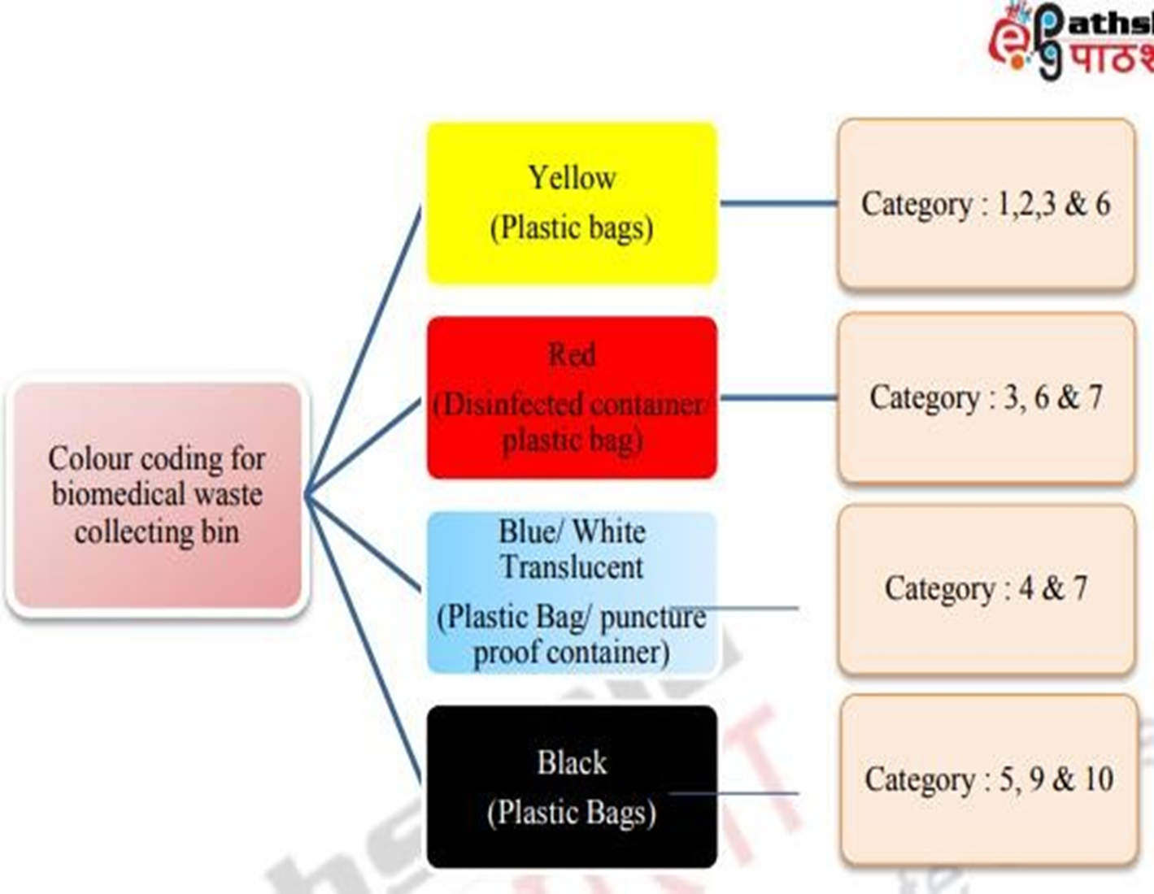

Slide 14
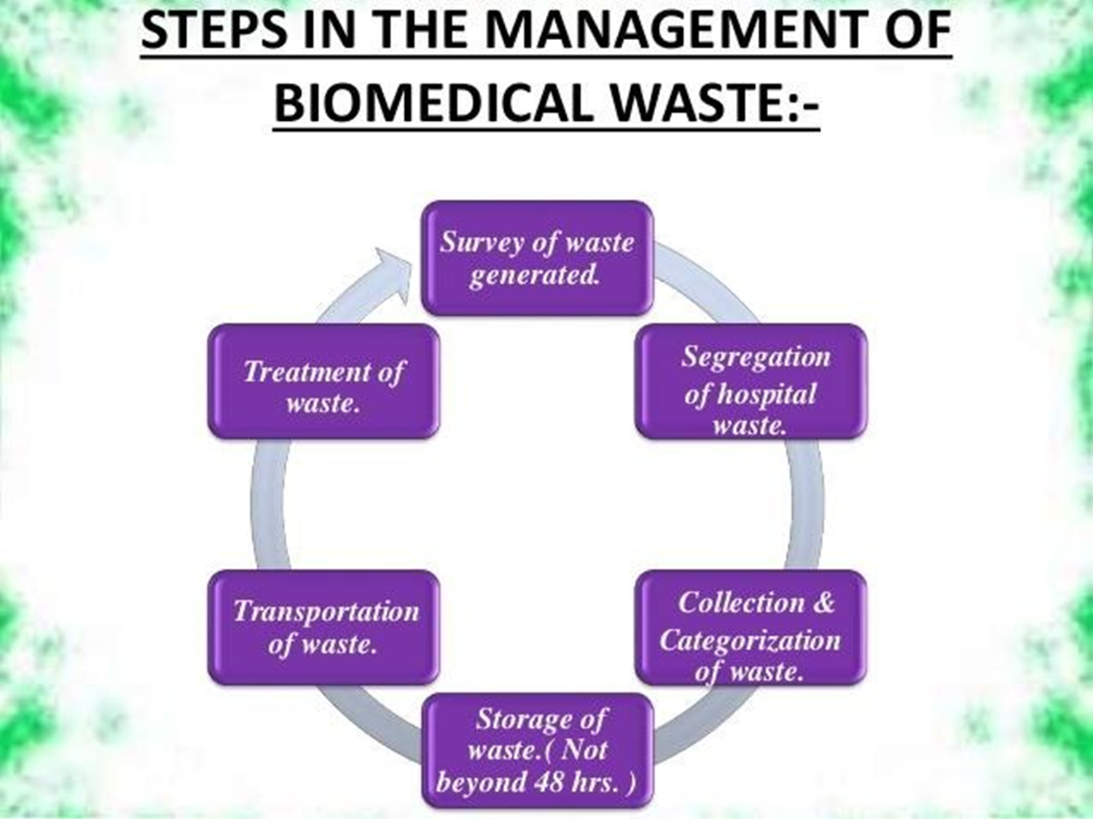

Slide 15
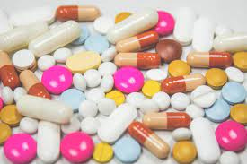
THAK
YOU

